Slide 1
Evolution of Mobile Apps
By Minh Nguyen

Slide 2
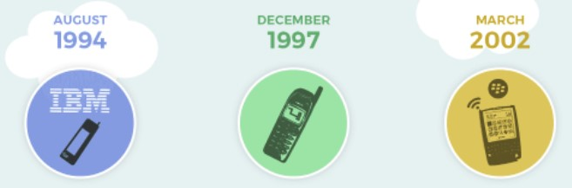
The Old-School Phones
_These first created smartphones include limited apps such as calendar, snake game, contact, clock, ringtone edit, etc.

Slide 3
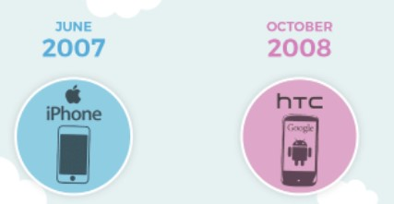
First Ever Apple & Android Phones
_First ever iPhone created in 2007, apps included were weather app, calculator, maps, text, text photos, etc.
_First ever Android created in 2008, apps included were mostly the same as iPhone.

Slide 4
Android Market & Apple App Store
_In 2008, Google launches the Android Market on every Android phones.
_In 2010, Android Market exceeded 1 billion downloads.
_In 2012, Android Market rebranded to Google Play.
_In 2009, Apple successfully launches the Apple App Store on their iPhones.
_Apple App Store had over 500 apps available to download at that time and over 10 million downloads within the first 3 days of launch and over 5 billion downloads within the first 2 months of launch.

Slide 5
Social Media
_Social Media apps such as Facebook, Instagram, Snapchat, etc remains on the top downloads. Facebook remains at the top 1 at the time.
_People have been socialize on social media apps since its first launched.

Slide 6
The Challenges of Mobile Apps
_Small view screen. For people that have weak eyes sights, it’s impossible for them to see texts like windows views.
_Speed. The processing speed on phone is pretty slow.
_Lack of windows tabs. On windows, we can see many windows tabs open as long as it fits on the screen, but on phone we can only see one window tab open at a time.

Slide 7
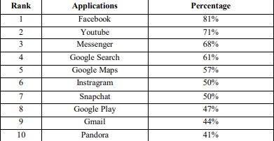
Most Downloaded Applications

Slide 8
The Important of Mobile Apps
_Nowadays, people cannot live without smartphones, so is mobile apps.
_Online shopping, food delivery, taxi service like Uber/Lyft, banking apps, entertainment apps, social media apps, any many more.
_People uses those app almost regularly for their needs.

